Slide 1
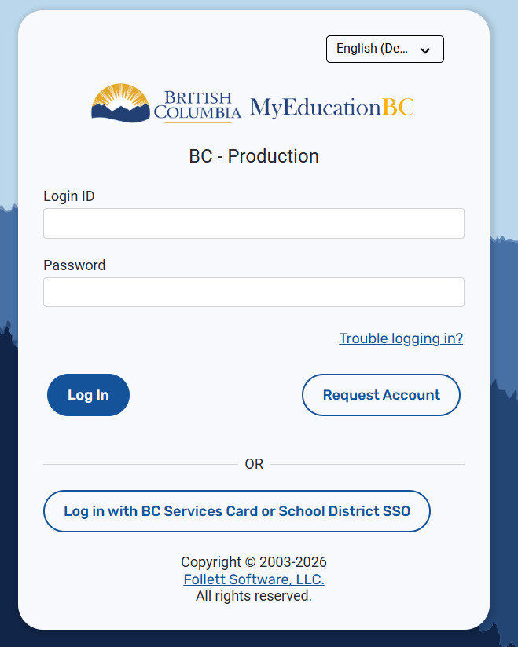
Course Selection
How to complete course selection on MyEd
https://myeducation.gov.bc.ca/aspen-login/?deploymentId=aspen

Slide 2
First of all . . .
OWN your academic path
Select required courses you have not yet successfully completed from the previous year
You are responsible to know your academic requirements to graduate. Select courses that meet the requirements for graduation

Slide 3
Step 1 – Log in
Navigate to MyEd: https://myeducation.gov.bc.ca/aspen-login/?deploymentId=aspen
Login with s68.######## (S.your student number)
If you do not know your password, see Donna or Mr Halsall in the main office

Slide 4
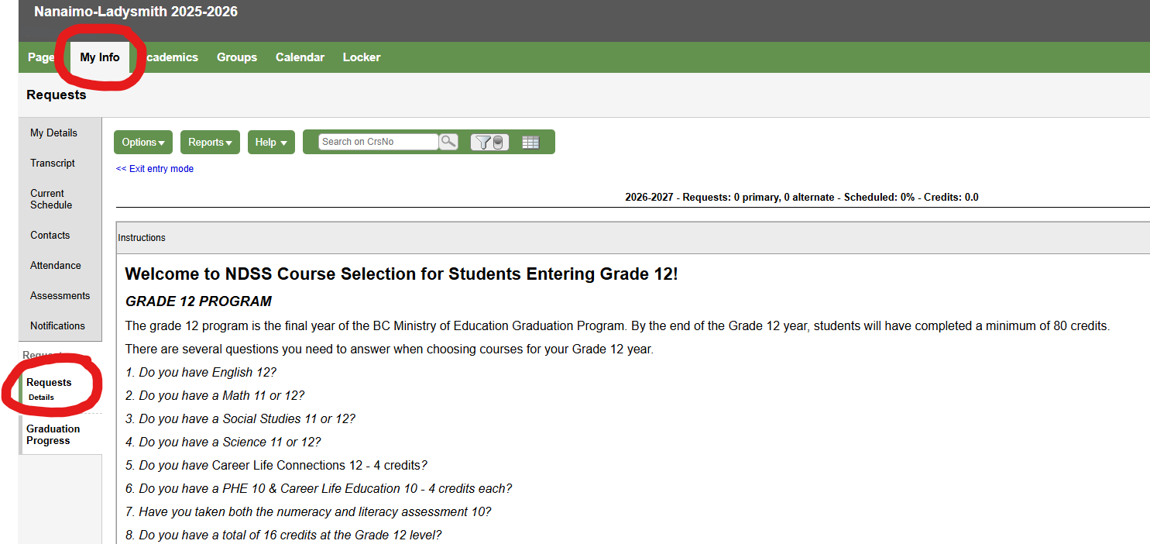
Step 2 – Find your request tab
1. Navigate to the top tab for info
2. Find the request button on the side

Slide 5
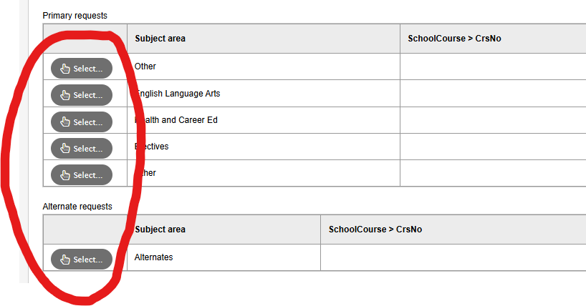
Step 3 – Follow the guide
1. Read the whole instructions first
2. Ensure you understand all required courses
3. Use the “select” button to pick courses

Slide 6
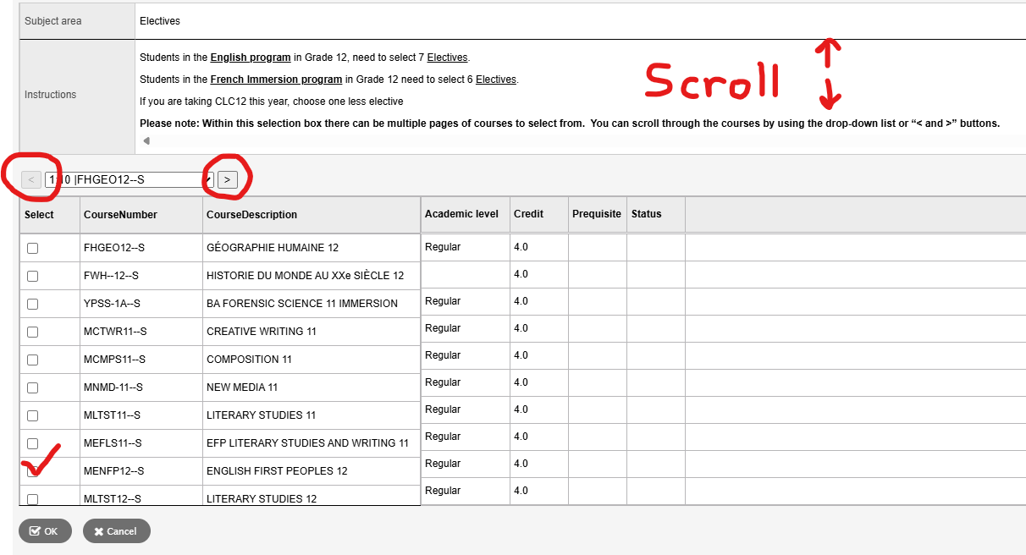
Step 3 – Follow the guide
1. Each subject area will have its own instructions
2. Make sure to scroll in the top instruction area
3. Use the < and > to scroll between course options
4. Check the select box on the left of courses you want
5. Click OK when done in each section

Slide 7
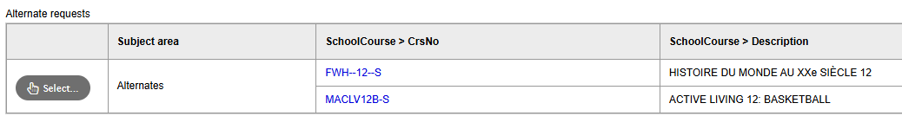
Step 4 – Select Alternates
1. Select Alternate options for your electives and rank them with a priority
2. This list is the same as the “elective” subject area

Slide 8
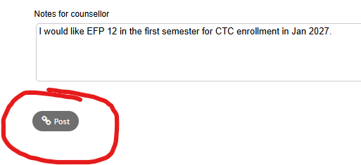
Step 5 – Review and Comments
1. Add a note to the counsellor for any special requests or any academy notes
2. When you are done, make sure to click “Post”
3. You can go back and edit any of your selections during the two-week period the selection is open

